Slide 1
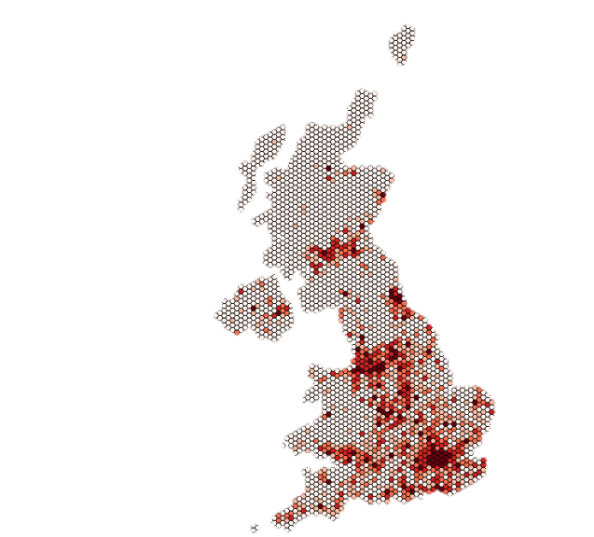
Twitter Topics Geography of the UK EU Referendum 2016
Rob Webster

Slide 2
Who is Rob Webster?
BSc Geography (2012 – 2015)
MSc GIS (2016 – 2017)
Previously at Sterling Geo.
Now Trainee Software Engineer @IMGeospatial
Notes:
Who Am I? (30 seconds)
What am I interested in?

Slide 3
Why look at EU Referendum using data from Twitter?
Massive source of time series data – Good for looking at events
Geolocated
Available to get data through API
Use R!!!!
library(tools)
library(rgdal)
library(GISTools)
#Define Projections
ukgrid = "+init=epsg:27700"
latlong = "+init=epsg:4326"
for(i in 1:19){ #for each week
Directory <- paste("~..../WK",i,sep = "") #set to weeks directory
setwd(Directory)
filenames <- list.files(, pattern = ".csv")
for(j in 1:length(filenames)) { #for each topic
Name <-file_path_sans_ext(filenames[j]) #gets tweets from a
particular week
Name_Split <- strsplit(Name, "_")[[1]]
Week <- Name_Split[2] # gets week from filename
Topic <- Name_Split[4] # gets topic from filename
Tweets <- read.csv(filenames[j]) #loads tweets
print(paste("Starting",Name,sep = " "))
Tweets_Bare <- Tweets[,c(8,16,23,44:45,50)] #removes data not
required
names(Tweets_Bare)[names(Tweets_Bare)=="place_lon"] <-
"Easting" # changes names of location variables
names(Tweets_Bare)[names(Tweets_Bare)=="place_lat"] <-
"Northing"
Tweets_Bare <- with(Tweets_Bare, Tweets_Bare[!(Easting == "" |
is.na(Easting)), ])
Tweets_Bare <- with(Tweets_Bare, Tweets_Bare[!(Northing == "" |
is.na(Northing)), ]) #removes those with no location data (already
applied but another check)
colnames(Tweets_Bare)[2]<- "Created" #rename cols
colnames(Tweets_Bare)[3]<- "User"
colnames(Tweets_Bare)[6]<- "Topic"
coordinates(Tweets_Bare) <- ~Easting + Northing #set coordinate
variables
proj4string(Tweets_Bare) <- CRS(latlong) #set projection
Tweets_BNG <- spTransform(Tweets_Bare,ukgrid) #transform to
required projection
td <- ("...../Points") # set to folder for saving
writeOGR(Tweets_BNG,td,paste(Name,"Pts"), driver="ESRI
Shapefile") #write shapefile to folder
}
}
Notes:
Motivations
Brilliant source of information, depth, lots and lots!!!
Interest in politics
Geolocated
Easily accessible

Slide 4
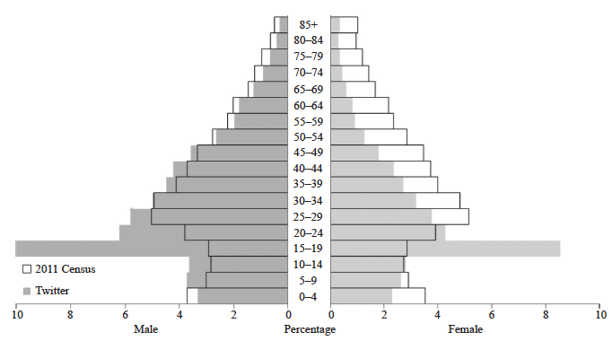
Limitations to consider
Age Distribution of Twitter Users in London compared with the 2011 Census. Originally Taken from Longley, Adnan & Lansley, 2015
Notes:
However as with most VGI you have to consider the validity and representativeness of the data you are using.

Slide 5
Research Questions
1 ) How did topics during the EU referendum campaign change on twitter throughout the course campaign and did this change spatially?
2) Does twitter highlight any events that appeared to shape the campaign on the platform and where was this most prevalent?
3) Is it possible to infer any relationships between twitter topics/intensity and votes at a constituency level?
Notes:
So basically I had these three research questions:
1 ) How did topics during the EU referendum campaign change on twitter throughout the course campaign and did this change spatially?
2) Relating to what events shaped the campaign on twitter
3) And finally, look at if it’s possible to link results to twitter activity, and any insights twitter may give.

Slide 6
Obtaining the data
Given access to Archive of Tweets. Selected tweets from Feb to June 2016.
Searched and Filtered using Keywords and Hashtags relating to the referendum.
Also collected a random sample of tweets too.
Filtered to remove spam accounts, duplicates etc.
Split tweets into weeks.
Tweet Search Terms referendum, eu, brexit , vote, remain, leave, europe, campaign, #strongerin, #remain, #voteremain, #votein, #bremain, #labourin, #votestay, #intogether, #labourinforbritain, #greenerin, #yes2eu, #yestoeu, #betteroffin, #votein, #ukineu, #bremain,#strongerin,#greenerin,#britin,#projectfact,#remaineu,#leavechaos, #voteleavelosecontrol,#niineurope,#scotlandineurope,#scotlandineu,#voteleave, #leaveeu,#takecontrol,#betteroffout,#voteout,#beleave,#no2eu,#betteroffout,#notoeu,#britainout,#loveeuropeleaveeu,#grassrootsout,#projectfear,#scexit

Slide 7
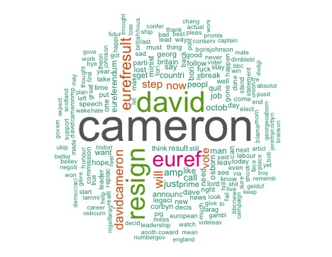
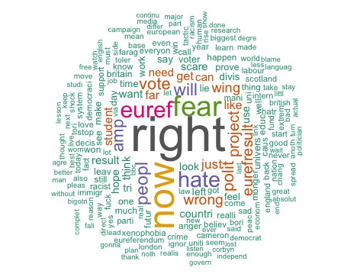
Topic Modelling
Used R and the topicmodels package to classify each tweet into topics.
LDA topic model applied.
Each tweet classified into a Number.
Numbers then manually classified to Topic Name using Word Cloud.
Unrelated topics removed.

Slide 8
Analysis Preparation
Tweets aggregated by area, with an Odds Ratio calculated using the Sample Tweets for each topic.
Tweets aggregated to two area types
Hexagonal Grid – For spatial analysis.
Constituency – For comparison with Estimated Referendum Result.
Spatial Analysis – GeoDa
Moran’s I
Getis-Ord
Regression Analysis – Spatial Error Model

Slide 9
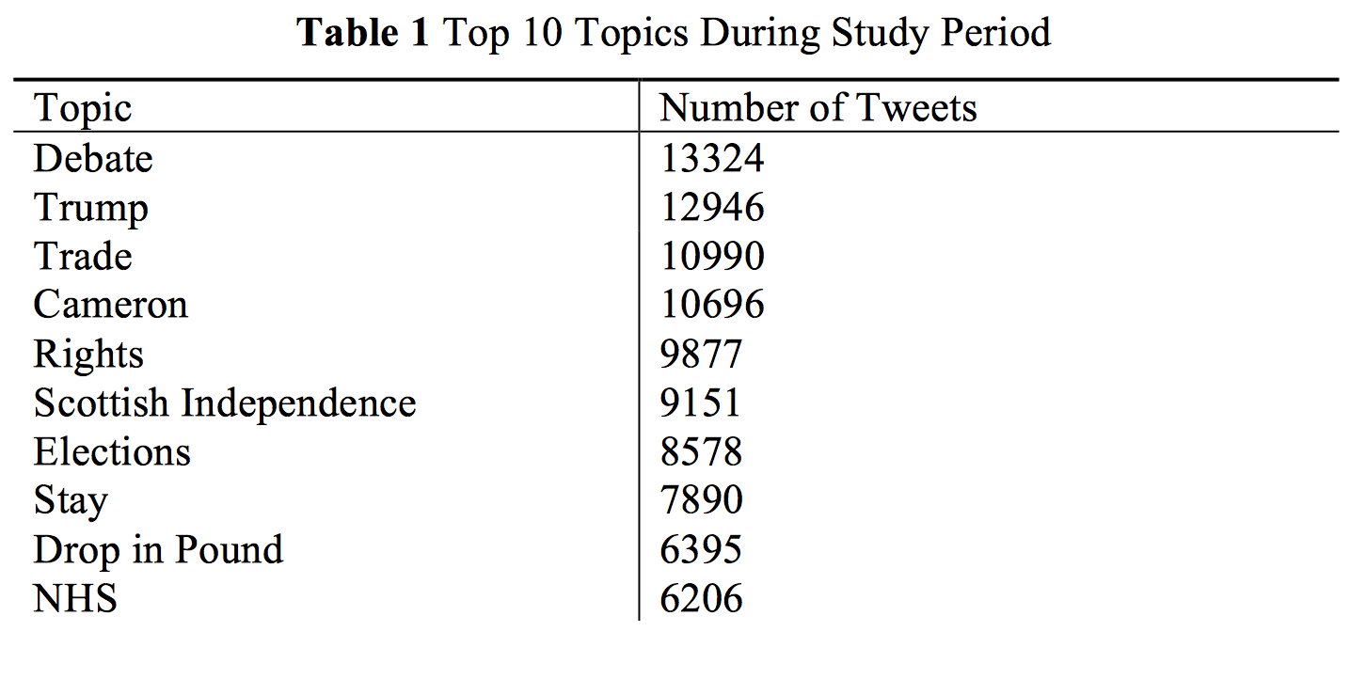
Summary of Tweets and Topics
291,797 Tweets classified as Referendum related.
102,941 unique users
111 Topics, Peak of 31 topics for a single day.

Slide 10
Summary of Results
Generally, Twitter activity was restricted to the same areas throughout the campaign

Slide 11
Evolution of Topic Discussion
Notes:
Example of how topic discussion varied.
Week 1 – Renegotiation deal unveiled and Referendum date announced. Reasonably High activity
Considerably drops week 2
Week 19 – Cameron resigns following the result, talked about a lot but…

Slide 12
Summary of Results
Generally, Twitter activity was restricted to the same areas throughout the campaign
Very few Topics generated large engagement through most of the campaign, restricted to those very engaged politically (Westminster Bubble?).

Slide 13
Notes:
It can be established that following an initial surge in interest that there was a lull in interest in the topic, with activity mostly confined to politically engaged users for much of the campaign. As the referendum date neared, engagement in topics increased, with many more areas of the country becoming engaged with the various topics of the referendum.

Slide 14
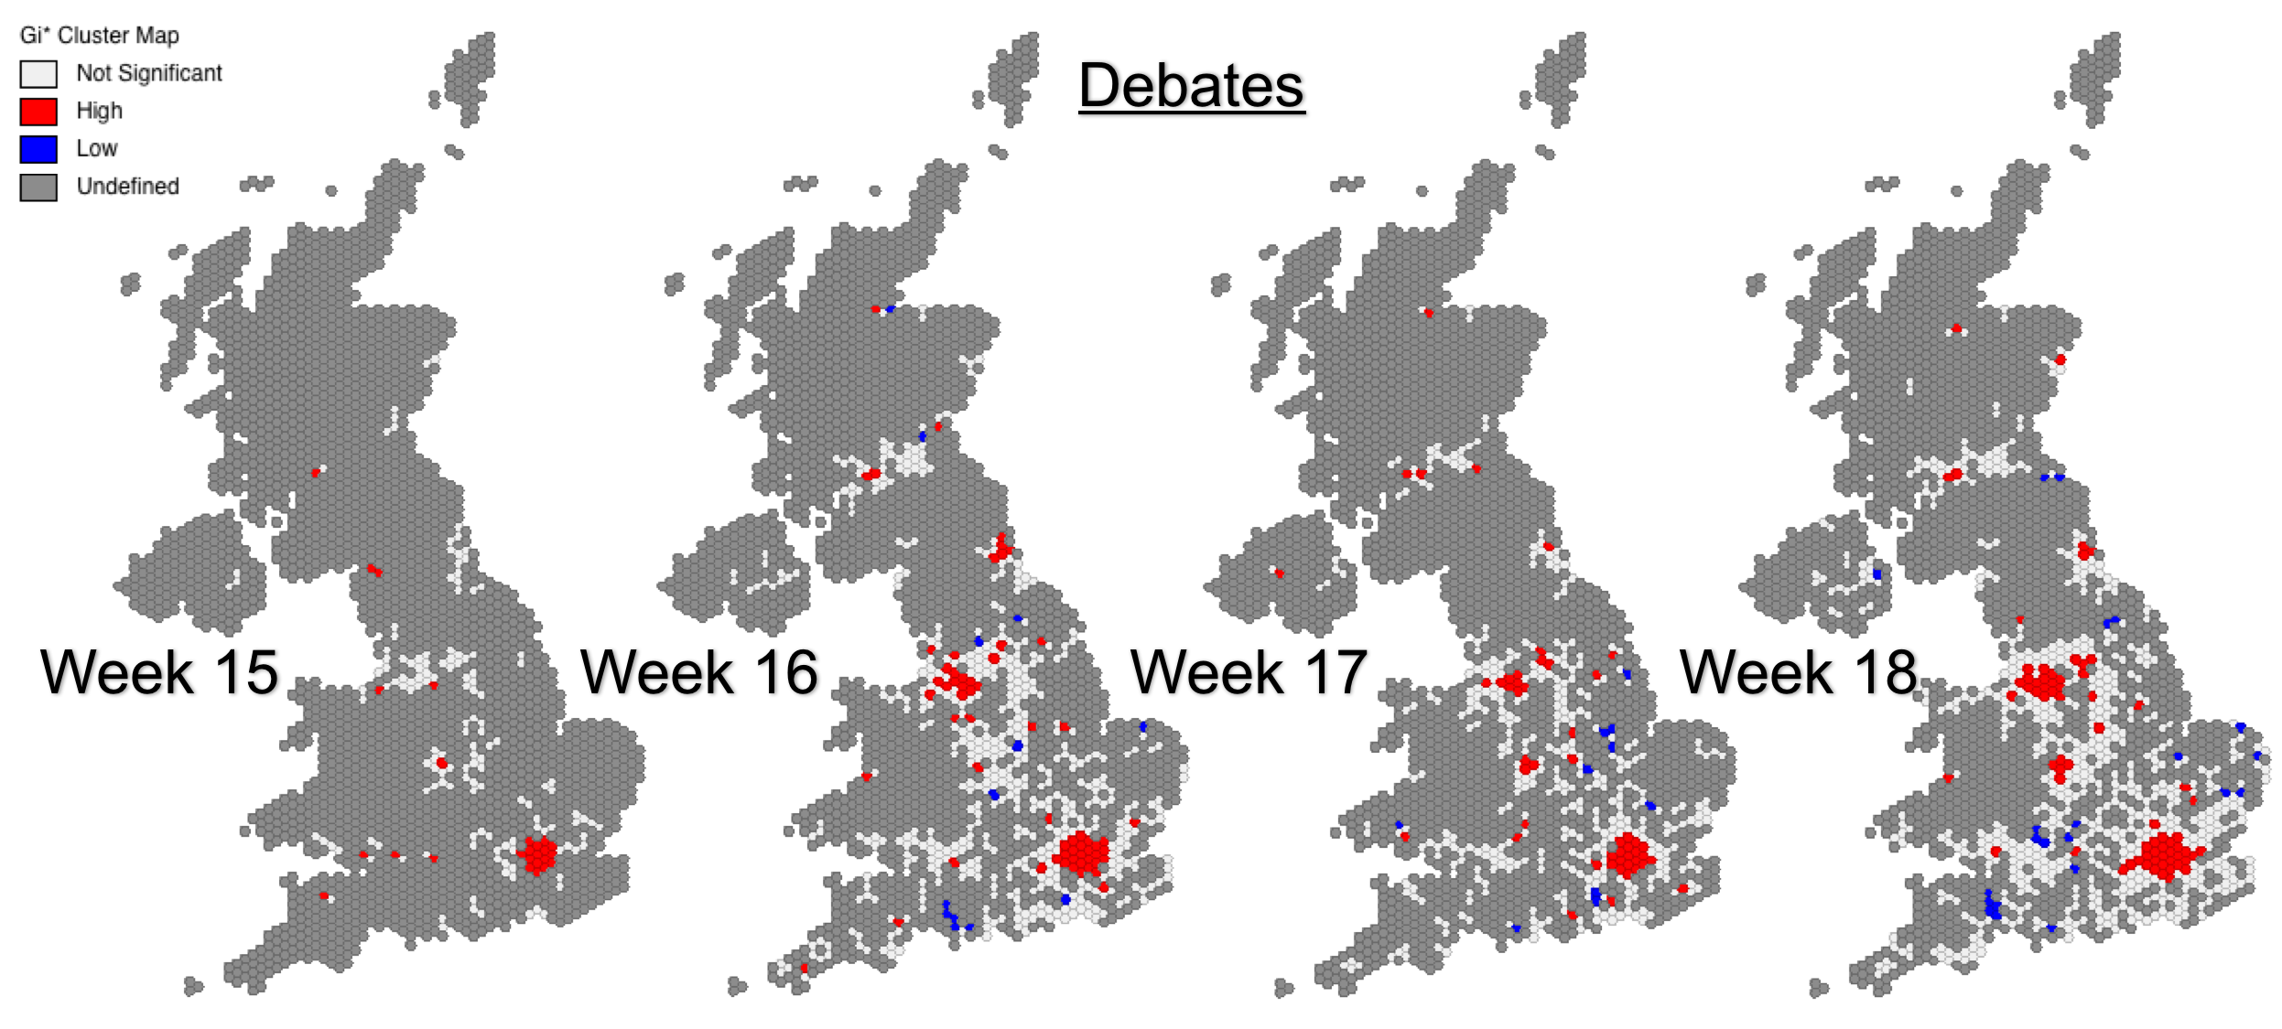
Notes:
There were numerous events that drove discussion on the platform, with the TV debates not only driving activity about them, but also the various topics they discussed and proving to be key points in the overall discussion of the campaign.

Slide 16
Summary of Results
Generally, Twitter activity was restricted to the same areas throughout the campaign
Very few Topics generated large engagement through most of the campaign, restricted to those very engaged politically (Westminster Bubble?).
Clear switch in engagement after the Referendum result with topics. Unsurprising, it was unexpected!!

Slide 17
Topics Extracted
Week 18 (Before the Result) | Week 19 (After the result)
Debate | Another Referendum | Lies
Geldof Farage | Boris Johnson | Move
Jo Cox | Cameron | NHS
Law | Change | Passport
NHS | Control | People Racist
People | Democratic | Pound Drops
Political Parties | Election | Racist
Referendum | Fear Hate | Sad
Stronger In | Feelings | Scottish Independence
Take Back Control | Free Movement | Shock
Trade | Future | Thought
Turkey | Generations | Trade
Vote Leave | Good Bad Thing | Trump
Workers Rights | Happen | Wake Up to Result
 | Important Vote | Working Class
 | Labour Corbyn
Notes:
Difference between topics in the last week of the campaign and the week following the result.
Lot’s of topics, feelings, very emotive
Before limited topics, very specific.

Slide 18
Notes:
Change in OR can be observed from before and after the result
Correlation between increase in Vote for leave, and reduction in OR for a constituency.
Linked to the demographic make up of Twitter?
Remain constituencies typically Urban, again young and perhaps unsurprising?

Slide 19
Notes:
Two Topics from Week 19
2nd referendum widely discussed, Lies less so.
However, when compared with Estimated Constituency results, the Lies topic has a very strong negative correlation when using OLS, meaning that as Leave vote decreased within a constituency, the stronger the OR for this topic, indicating it was a strong topic amongst remain leaning constituencies. When using a spatial error model, it still maintained a strong negative correlation when compared to other topics.

Slide 20
Reflections on results
GWR should have been used, for more rigorous testing between constituency voting and twitter topics. Spatial Error model an base indicator.
More work needs to be done on the topic modelling, a good process but needs finesse and understanding of representativeness. Subjective.
Perhaps another approach to examining events through social media could have been explored. Of all the events through the campaign that generated the widest engagement, it was the Result, highlights difficulty of measuring topics/opinions on the platform and making it useful.
Always needs to be framed within twitter, not trying to project onto beyond the platform onto general population (e.g. opinion polling using social media).

Slide 21
Thank You and Enjoy the rest of GISRUK!!! ☺ Any questions feel free to chat or contact me elsewhere.
@RobWebsterUK
www.linkedin.com/in/rob-webster-geo
rob.a.webster1@gmail.com

